Slide 1
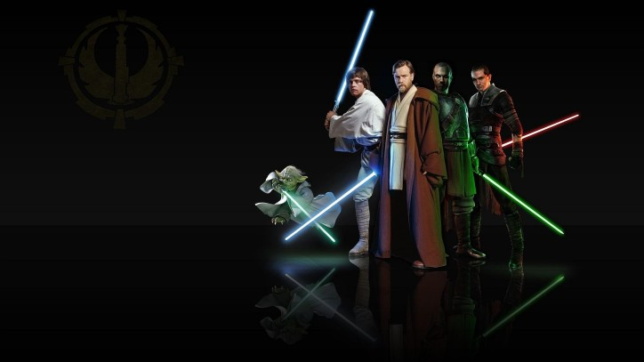
Fake News JEDI !
Aravind
Cliff
Daniel
Jenny
Jordan
Moneka
Narek
Naveen
Soheil

Slide 2
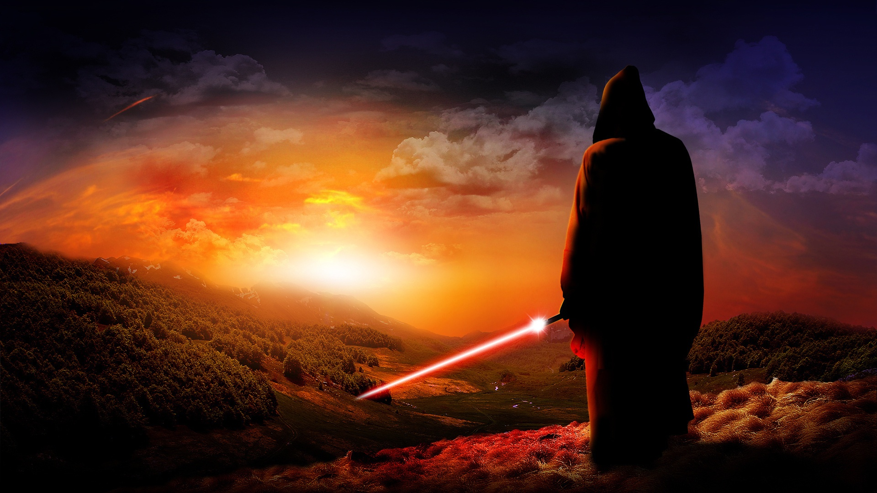
The Challenge!
Fake News is everywhere!
...
..
.

Slide 3
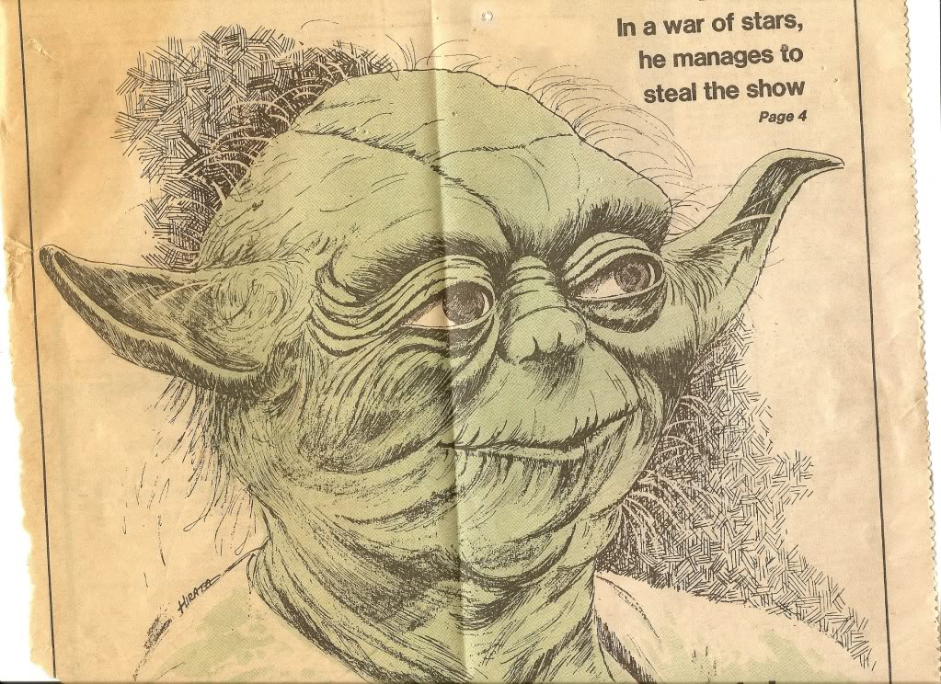
Our Solution

Slide 4

The Approach

Slide 5
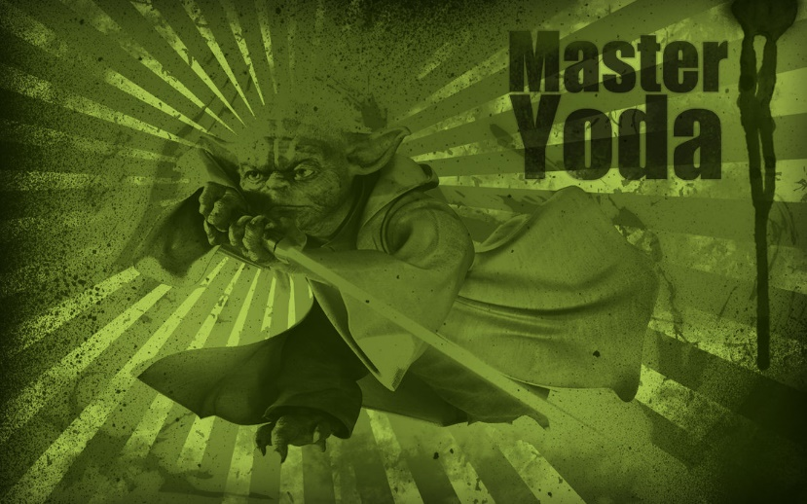
How Smart is it ?
KS Model Results

Slide 6
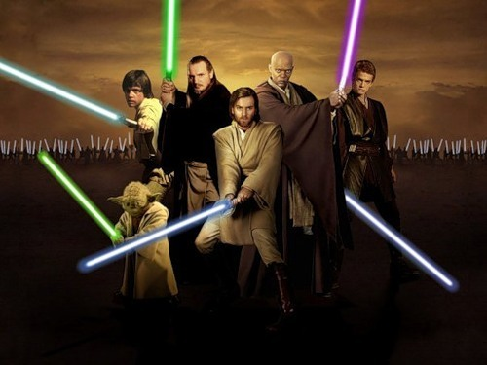
Results

